Slide 1
Lesson 4
Impact with a Fixed Surface
Consider a sphere A, of mass m, moving with speed u on a smooth horizontal plane in a direction which is at 30° to a smooth vertical wall
with which it collides and then bounces off.
At the moment of impact, an impulse perpendicular to the wall acts on the sphere.
(An equal and opposite impulse acts on the wall.)

Slide 2
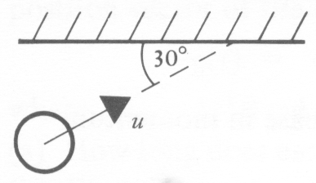
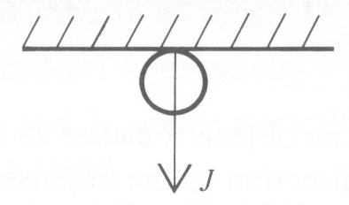
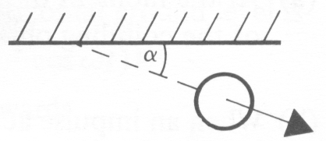
Just before impact
At impact
Just after impact

Slide 3
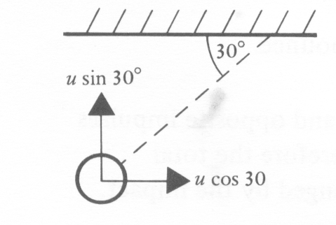
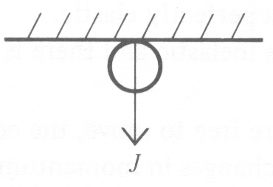
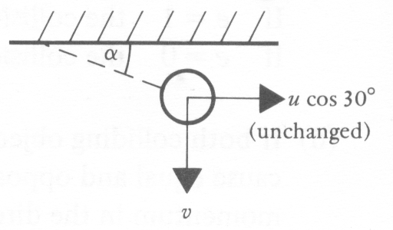
The impulse J causes a change in momentum perpendicular to the wall.
Parallel to the wall, where there is no impulse, there is no change in momentum
and therefore no change in the velocity component.
this property is incorporated in the following diagrams.

Slide 4
Component parallel to plane is the same ie.
u cos θ = v cos α
Component perpendicular to plane is changed
according to e
Using v = e u
v sin α = e u sin θ
To calculate impulse:-
Use perpendicular component only,
I = m (v sin α ) – m (- u sin θ )

Slide 5
Note that the first set of three diagrams (opposite), which were drawn to illustrate the given information, were not suitable as 'working diagrams' for the solution.
The second set of three are the working diagrams. It is unwise to attempt any oblique impact problem without such a set of clear diagrams showing the appropriate velocity components.

Slide 6
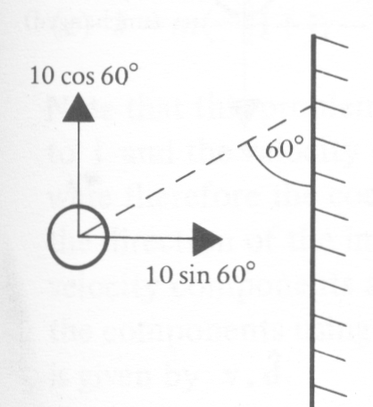
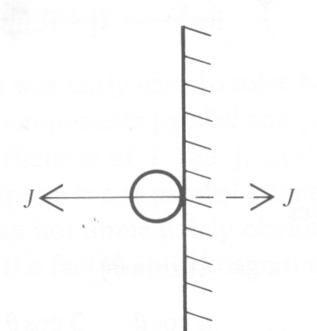
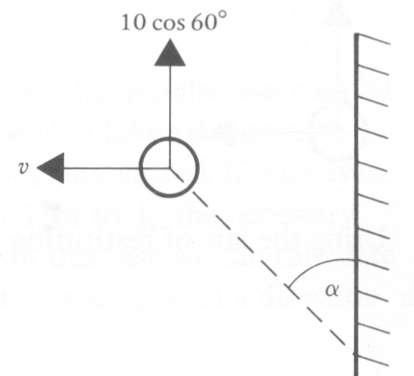
EXAMPLE 1) A smooth sphere is projected along a horizontal plane and collides obliquely with a vertical wall. Just before impact the sphere is moving with a speed of 10 ms⁻¹ at an angle of 60° to the wall.
If e=¼ find the speed of the sphere after impact and the angle, α, which its direction of motion then makes with the wall.
(Parallel to the wall there is no impulse, therefore no change in speed. This is shown on the diagram.)

Slide 7
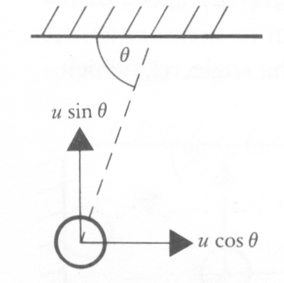
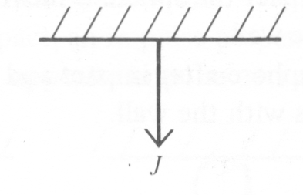
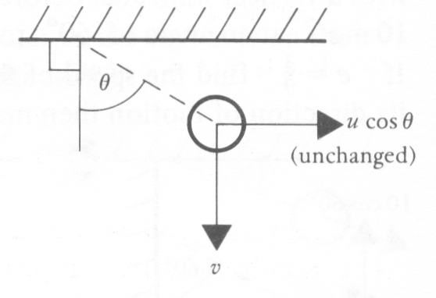
2) The coefficient of restitution between a snooker ball and the side cushion is 1/3. If the ball hits the cushion and then rebounds at right angles to its original direction, show that the angles made with the side cushion by the directions of motion before and after impact are 60° and 30° respectively.
Let the original speed be u,
in a direction making an angle θ with the side cushion.

Slide 8
3) A smooth sphere of mass m is moving on a horizontal plane with a velocity 3i + j when it collides with a vertical wall which is parallel to the vector j. If the coefficient of restitution between the sphere and the wall is ½, find
(a) the velocity of the sphere after impact,
(b) the loss in kinetic energy caused by the impact,
(c) the impulse J that acts on the sphere.

